Slide 1
Privacy-Preserving Collaboration Using Cryptography
Dr. Emily Shen
Briefing to the Federal Privacy Council 5 May 2020
DISTRIBUTION STATEMENT A. Approved for public release. Distribution is unlimited. This material is based upon work supported by the Under Secretary of Defense for Research and Engineering under Air Force Contract No. FA8702-15-D-0001. Any opinions, findings, conclusions or recommendations expressed in this material are those of the author(s) and do not necessarily reflect the views of the Under Secretary of Defense for Research and Engineering. © 2020 Massachusetts Institute of Technology. Delivered to the U.S. Government with Unlimited Rights, as defined in DFARS Part 252.227-7013 or 7014 (Feb 2014). Notwithstanding any copyright notice, U.S. Government rights in this work are defined by DFARS 252.227-7013 or DFARS 252.227-7014 as detailed above. Use of this work other than as specifically authorized by the U.S. Government may violate any copyrights that exist in this work.
Notes:
1
1

Slide 2



Need for Privacy-Preserving Collaboration
Social Good
Commercial Value
National Security

Slide 3



Privacy-Preserving Collaboration for National Security
Humanitarian Target Deconfliction
Satellite Collision Prediction
Collaborative Cyber Threat Analysis
Parties: humanitarian aid orgs, military
Private inputs: locations of sites, targets
Desired output: locations in common
Parties: international satellite operators
Private inputs: maneuver schedules
Desired output: potential collisions
Parties: companies, government
Private inputs: observed threats
Desired output: aggregate threat info

Slide 4
National Need for Privacy-Preserving Technology
National Privacy Research Strategy, 2016
Report of the Commission on Evidence-Based Policymaking, 2017
Foundations for Evidence-Based Policymaking Act of 2018
Student Right to Know Before You Go Bill, 2019
“How can privacy-enhancing cryptographic technologies be developed to scale?”
“Secure Multiparty Computation may allow […] combin[ing] data and conduct[ing] analyses without directly accessing or storing information.”
“facilitate data sharing, enable data linkage, and develop privacy enhancing techniques”
“the Commissioner shall use secure multiparty computation technologies”

Slide 5





Current Approaches to Collaboration
Share with each other
Share with an external party
Don’t share; don’t learn results
Bob
Bob
Bob
David
Alice
Charlie
Alice
Charlie
Alice
Charlie
Currently collaboration requires giving data to trusted parties, accepting security and privacy risks

Slide 6

Secure Multi-Party Computation (MPC)
Bob
Goal: replace trusted party with technology
Requirements:
Correctness: everyone learns correct result of computation
Security: no one learns anything beyond result
Secure multi-party computation (MPC) provides correctness and security without a trusted party
For any computation
For any number of parties
MPC invented in 1987, initially purely theoretical
In past decade, MPC implemented and becoming practical for many applications
MPC
Alice
Charlie
Secure MPC allows computing joint results without giving input data to any trusted party

Slide 7
Outline
Motivation
Secure Multi-Party Computation (MPC)
Lincoln MPC Framework
Prototypes and Deployments
Summary

Slide 8
How MPC Works (1)
Secret-Share Inputs
Split each input into random secret shares
Send a distinct share to each party

Slide 9
How MPC Works (2)
Secret-Share Inputs
Compute on Shares
Split each input into random secret shares
Send a distinct share to each party
Decompose computation into primitive operations
Iteratively compute primitive operations securely on shares

Slide 10
How MPC Works (3)
Secret-Share Inputs
Compute on Shares
Open Output Shares
Split each input into random secret shares
Send a distinct share to each party
Decompose computation into primitive operations
Iteratively compute primitive operations securely on shares
Send final shares to all parties
Combine final shares to obtain output

Slide 11

Example: MPC to Compute Average Salary
Alice, Bob, Charlie want to securely compute average of their salaries
Compute sum of salaries using MPC, then divide by 3
Bob
Inputs: Monthly Salaries
Output: Sum of Salaries
Alice
$8K
Bob
$12K
MPC
$30K
Charlie
$10K
Alice
Charlie

Slide 12

Secret Sharing Inputs (1)
Secret-Share Inputs
Compute on Shares
Open Output Shares
Inputs:
Monthly Salaries
Secret Shares (mod 100)
Output: Sum of Salaries
Alice
$8K
16
Bob
$12K
6
8 – (16 + 6) (mod 100) = – 14 (mod 100) = 86
Charlie
$10K
86

Slide 13
Secret Sharing Inputs (2)
Secret-Share Inputs
Compute on Shares
Open Output Shares
Inputs:
Monthly Salaries
Secret Shares (mod 100)
Output: Sum of Salaries
Alice
$8K
16
59
22
Bob
$12K
6
33
89
Charlie
$10K
86
20
99
8
12
10

Slide 14
Computing on Shares
Secret-Share Inputs
Compute on Shares
Open Output Shares
Inputs: Monthly Salaries
Secret Shares (mod 100)
Output: Sum of Salaries
Alice
$8K
16
+
59
+
22
=
97
Bob
$12K
6
+
33
+
89
=
28
Charlie
$10K
86
+
20
+
99
=
5

Slide 15
Opening Output Shares
Secret-Share Inputs
Compute on Shares
Open Output Shares
Inputs: Monthly Salaries
Secret Shares (mod 100)
Output: Sum of Salaries
Alice
$8K
16
+
59
+
22
=
97
Bob
$12K
6
+
33
+
89
=
28
$30K
Charlie
$10K
86
+
20
+
99
=
5

Slide 16
Correctness
Secret-Share Inputs
Compute on Shares
Open Output Shares
Inputs: Monthly Salaries
Secret Shares (mod 100)
Output: Sum of Salaries
Alice
$8K
16
+
59
+
22
=
97
Bob
$12K
6
+
33
+
89
=
28
Charlie
$10K
86
+
20
+
99
=
5
Everyone learns correct result of computation
Underlying Values
8
+
12
+
10
=
30

Slide 17
Security (1)
Secret-Share Inputs
Compute on Shares
Open Output Shares
Inputs:
Monthly Salaries
Secret Shares (mod 100)
Output: Sum of Salaries
Alice
$8K
16
+
59
+
22
=
97
Bob
?
6
+
?
+
?
=
28
$30K
Charlie
?
86
+
?
+
?
=
5
Underlying Values
8
+
?
+
?
=
30

Slide 18
Security (2)
Secret-Share Inputs
Compute on Shares
Open Output Shares
Inputs:
Monthly Salaries
Secret Shares (mod 100)
Output: Sum of Salaries
Alice
$8K
16
+
59
+
22
=
97
Bob
$9K?
6
+
?
+
?
=
28
$30K
Charlie
$13K?
86
+
?
+
?
=
5
No one learns anything beyond result of computation
Underlying Values
8
+
9
+
13
=
30

Slide 19
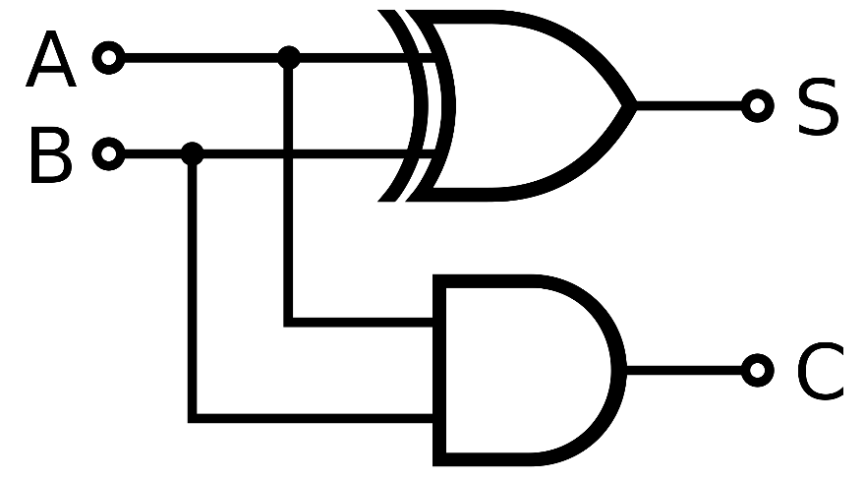
MPC for Any Function
MPC for Arithmetic Computation
MPC for Boolean Computation
u
+
v
×
y
+
w
MPC for add, multiply primitives over integers can securely compute any function!
MPC for XOR, AND primitives over bits can securely compute any function!
MPC can securely compute any function using arithmetic or Boolean primitives

Slide 20
Outline
Motivation
Secure Multi-Party Computation (MPC)
Lincoln MPC Framework
Prototypes and Deployments
Summary

Slide 21
Challenges of Building Complex MPC Functionalities
MPC Functionalities
?
MPC Primitives
Practical MPC development requires higher-level building blocks, data-oblivious algorithms, unique efficiency considerations

Slide 22

Rapid Assembly of MPC Protocols (RAMP) Framework
MPC Functionalities
Compositions of gadgets
Software abstractions allow multiple options for each computation
Evaluation tools measure theoretical and empirical performance
MPC Gadgets
Optimized data-oblivious algorithms for common building blocks
MPC Primitives
Low-level arithmetic and Boolean operations
Lincoln’s RAMP framework enables rapid prototyping of MPC functionalities

Slide 23
RAMP Gadget Approach
MPC Functionalities
Set Intersection
MPC Gadgets
Merge
Sort
Deduplicate
Comparison <
Equality =
MPC Primitives
Add +
Mult ×
XOR ⊕
AND ∧

Slide 24
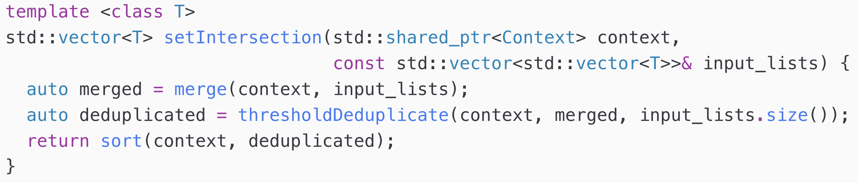
Implementation of MPC for Set Intersection
Gadgets abstract thousands of lines of code to make MPC functionalities easy to prototype

Slide 25
Example Performance of MPC for Set Intersection
Total Time
Results available in 4 minutes for 3000 inputs
Time After Preprocessing

Slide 26
RAMP Gadget Library
Arithmetic
Fixed-point arithmetic
Sort
arithmeticSum
arithmeticSumOfList
cumulativeSum
exponentiate
popCount
product
productVectorDifferentSizes
singleRoundAdditionHelper
subtract (secret-secret)
subtract (public-secret)
subtract (secret-public)
sum
fixedPointAdd
fixedPointDiv
fixedPointMult
mergeVectorsShortestFirst
mergeVectorsTreePattern
oddEvenMerge
oddEvenMergeSort
sort
sortPairsByFirstElement
Equality
equality (bool)
equality (arith)
equalityUsingRandomBitwiseShares
fermatEquality
Set operations
deduplicate (bool)
deduplicate (arith)
distinctCountFromIndicators (bool)
distinctCountFromIndicators (arith)
distinctCountOfSorted
setIntersectionCardinality (bool)
setIntersectionCardinality (arith)
thresholdDeduplicate (bool)
thresholdDeduplicate (arith)
thresholdSetIntersection
thresholdSetIntersectionCompaction
vectorizedThresholdVectorEquality
Comparison
bitwiseSharesLessThanModulus
bitwiseSharesLessThanPublicValues
comparator
greaterThan (bool)
greaterThan (arith)
greaterThanThreshold
greaterThanWithinHalfField
lessThan (bool)
lessThan (arith)
lessThanWithinHalfField
linearGreaterThan
maskWithBitwiseRandomSharesAndOpen
max
maxWithinHalfField
min
minWithinHalfField
publicValuesLessThanBitwiseShares
treewiseGreaterThan
Boolean operators
bgwNot
bgwOr
bgwXor (secret-secret)
bgwXor (public-secret)
bitmaskVectorAnd (bool)
bitmaskVectorAnd (arith)
bitmaskVectorOr (bool)
bitmaskVectorOr (arith)
bitwiseToSingleShare
leastSignificantBit
linearPrefixOr
mux (bool)
mux (arith)
Linear algebra
innerProduct
outerProduct
matMult (secret-secret)
matMult (public-secret)
matMult (secret-public)

Slide 27
Outline
Motivation
Secure Multi-Party Computation (MPC)
Lincoln MPC Framework
Prototypes and Deployments
Summary

Slide 28


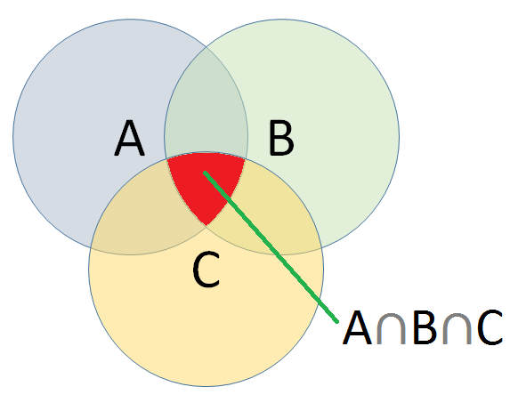
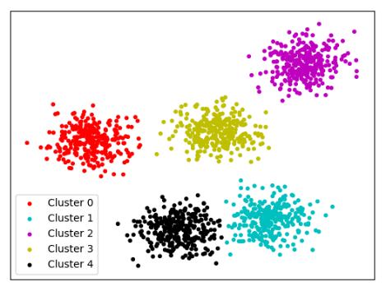
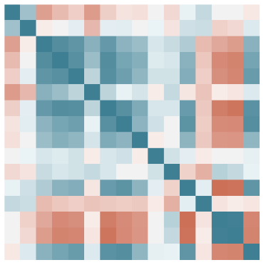


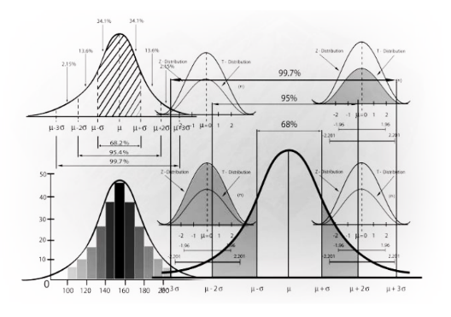
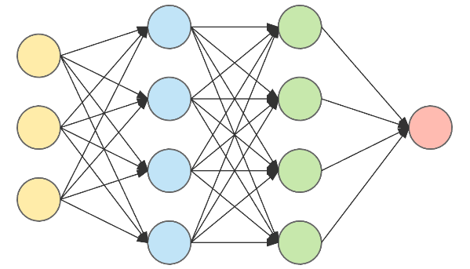

MPC Applications Prototyped
Joining IP blacklists
Similarity-based clustering
Detecting coordinated attacks
Computing statistical summaries
Training neural networks for genomic computation
Merging personnel datasets

Slide 29

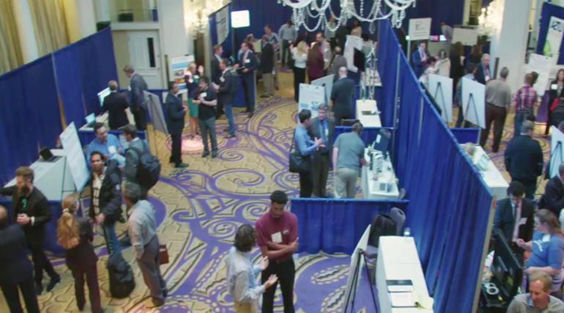
Publications and Presentations
IEEE HPEC
IEEE Computer Magazine
IEEE SecDev
Book Chapter: Cryptography for Big Data Security
DHS S&T Cybersecurity Showcase

Slide 30
Summary
Secure multi-party computation enables privacy-preserving collaboration
MPC can securely perform any computation in theory
Lincoln has developed a rapid prototyping framework to address practical MPC development challenges
Applying MPC to cyber security and other mission areas
Ongoing work: exploring additional applications, improving performance and usability, transitioning framework

Slide 31
Contact Information
Dr. Emily Shen
emily.shen@ll.mit.edu

